Slide 1

POCKETKIT
A MULTIUTILITY APP
https://pocketkit.herokuapp.com

Slide 2

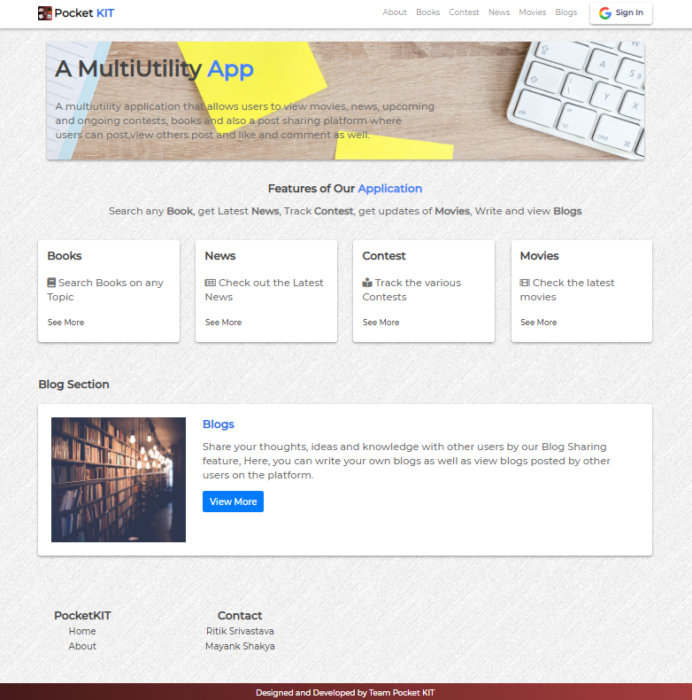

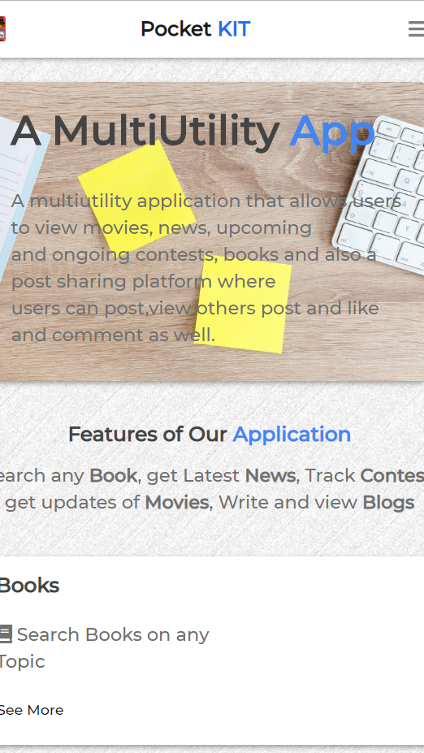
INTRODUCTION
POCKETKIT is a multi utility web application that that allows users to search and view movies, news, upcoming and ongoing contests, books and also a blogs sharing platform where users can post, view blogs posted by other users on the platform and like and comment on them as well.

Slide 3
TECHNICAL DETAILS
Backend: Node.js + Express.js
Frontend: HTML + CSS + Bootstrap + Javascripts
Database: MongoDB (Database as a Service)
Tools and Libraries:
Google OAuth20, Passport, EJS, Axios
APIs used:
Google Books API, NewsAPI, All Contests Tracker API, OMDB API
Hostings:
Source: Github https://github.com/ritiksr25/pocketkit
Application: Heroku https://pocketkit.herokuapp.com
Database: MongoDB Cloud (AWS)
Images Storage: Cloudinary

Slide 4
FEATURES
Simple, Easy to use User Interface
Accessible over all platforms
Multi utility Application
Books module
Contest module
News module
Movies module
Blogs module

Slide 5
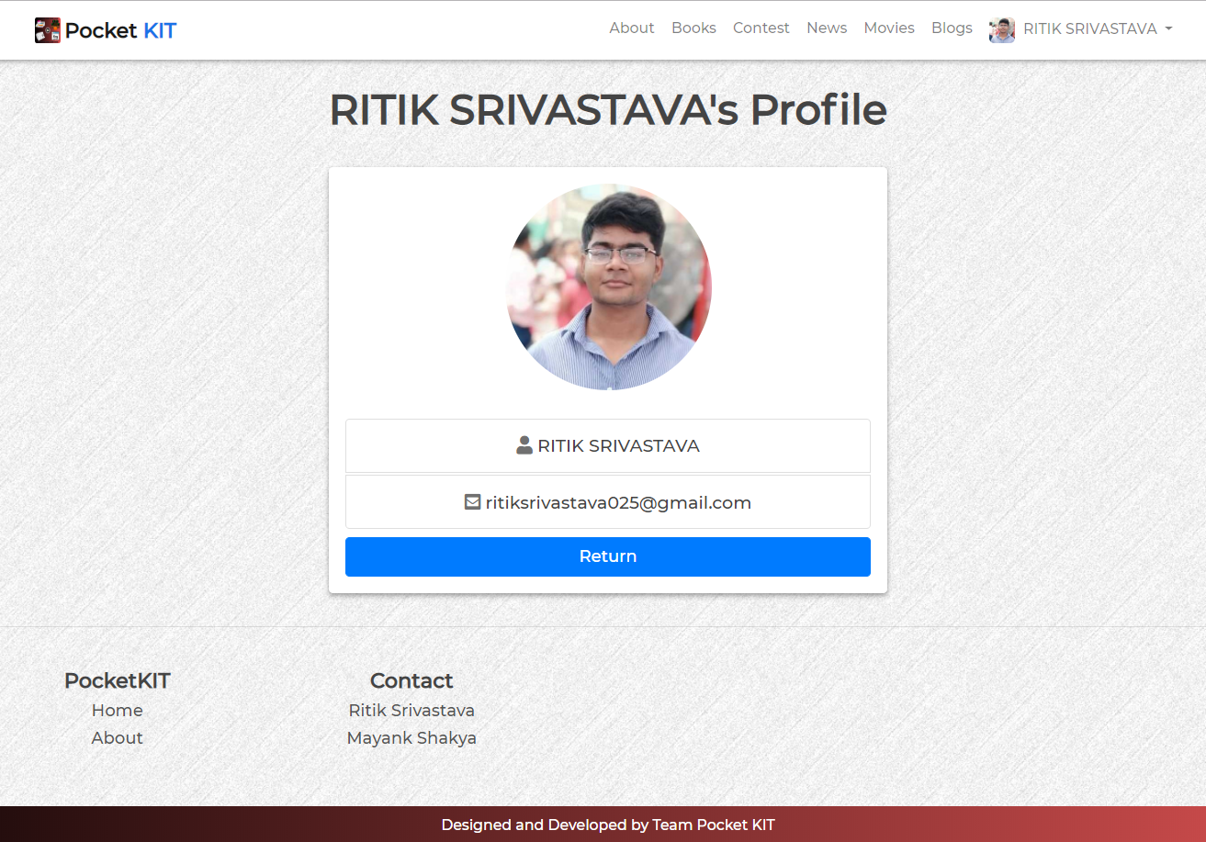
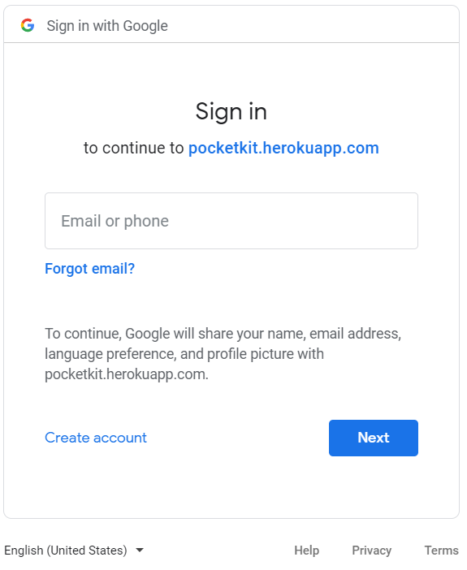
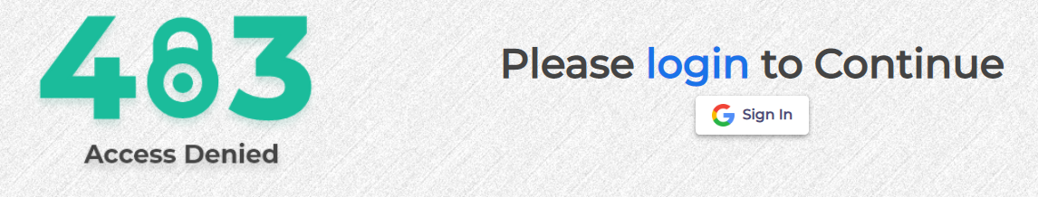
AUTHENTICATION MODULE

Slide 6
AUTHENTICATION MODULE
The access to the features/modules of Application has been limited without authentication, i.e. A user has to be logged in in order to access the features of the application.
Procedure for Login:
Click on the Sign In button at the top right corner.
It will redirect to the Google OAuth20 for authentication.
Sign in with the existing Google credentials.
User will be logged in and redirected to homepage.
Details saved in database from Google OAuth20:
Google ID
Name
Email
Profile Picture

Slide 7
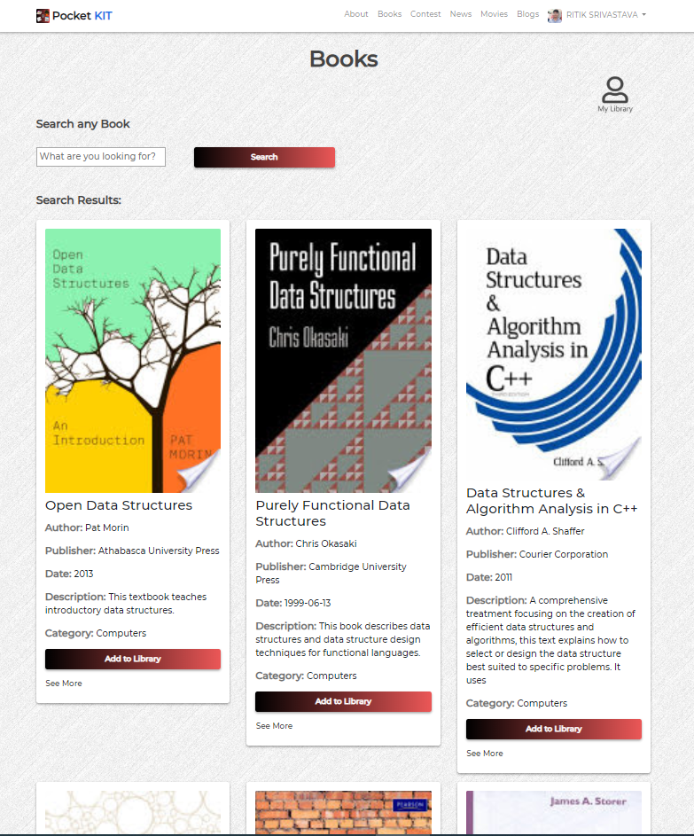
BOOKS MODULE

Slide 8
BOOKS MODULE
The Books module consists of Searching books by entering a search keyword, then a list of relevant books are displayed on the screen. User may click on the see more link to visit the Google Books for more details on the book and can also save a book for later use by clicking on Add to Library option on the book details.
The API used for searching books is Google Books API.
Workflow:
User makes a search request.
Request processed in Backend.
Request sent to API for results.
API sends data in JSON format to backend.
Backend receives, process, and send results to frontend.
Results are displayed to the user.
If user adds to Library, details are saved in the database and user can view it later.

Slide 9
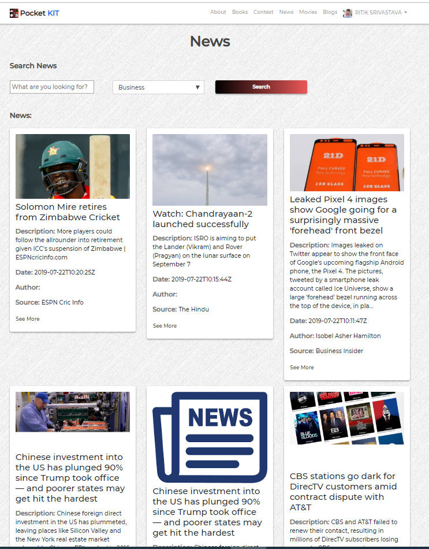
NEWS MODULE

Slide 10
NEWS MODULE
On the index Page of the News, latest news feed will automatically be displayed from all categories and various news sources, predefined in the application. The details and full article can be viewed by clicking on the see more option on each news.
Along with this, user has an option to search the news based on a search query or filter news based on categories.
The API used for news is Newsapi.org
Workflow:
User makes a search request.
Request processed in Backend.
Request sent to API for results.
API sends data in JSON format to backend.
Backend receives, process, and send results to frontend.
Results are displayed to the user.

Slide 11
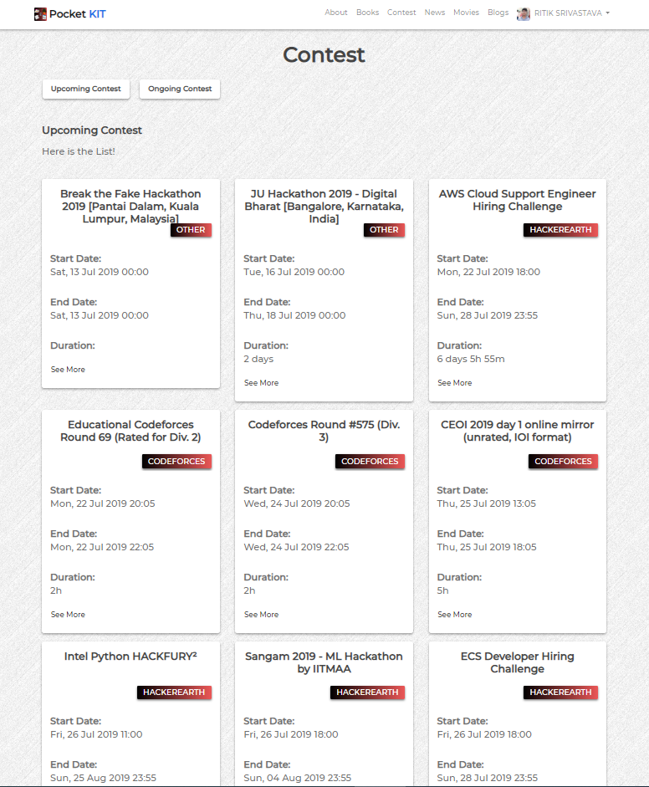
CONTESTS MODULE

Slide 12
CONTESTS MODULE
In the contests module, User can select and view latest upcoming and ongoing coding contests, challenges, hackathons, hiring challenges, etc. going across various online coding platforms like Hackerrank, Hackerearth, Codechef, etc.
API used for the Contests module is allconteststracker.herokuapp.com
Workflow:
.
Request sent to API for results.
API sends data in JSON format to backend.
Backend receives, process, and send results to frontend.
Results are displayed to the user.

Slide 13
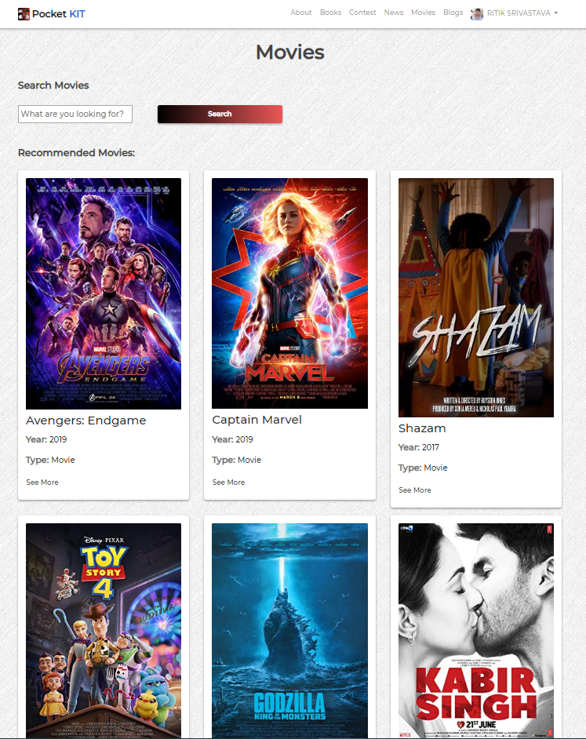
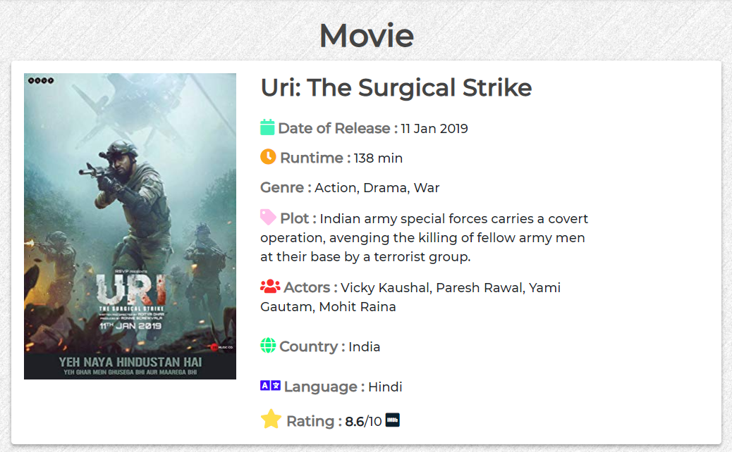
MOVIES MODULE

Slide 14
MOVIES MODULE
The movies module is also similar to the news module. The index page displays some recommended movies from both Hollywood and Bollywood categories. User can view various details of the movies like story plot, category, actors, release date, ratings, etc.
There is a search option where users can search for specific movies according to their choice and view the details of the movies.
The API used for this module is OMDB API (Open Movie Database).
Workflow:
User makes a search request.
Request processed in Backend.
Request sent to API for results.
API sends data in JSON format to backend.
Backend receives, process, and send results to frontend.
Results are displayed to the user.

Slide 15
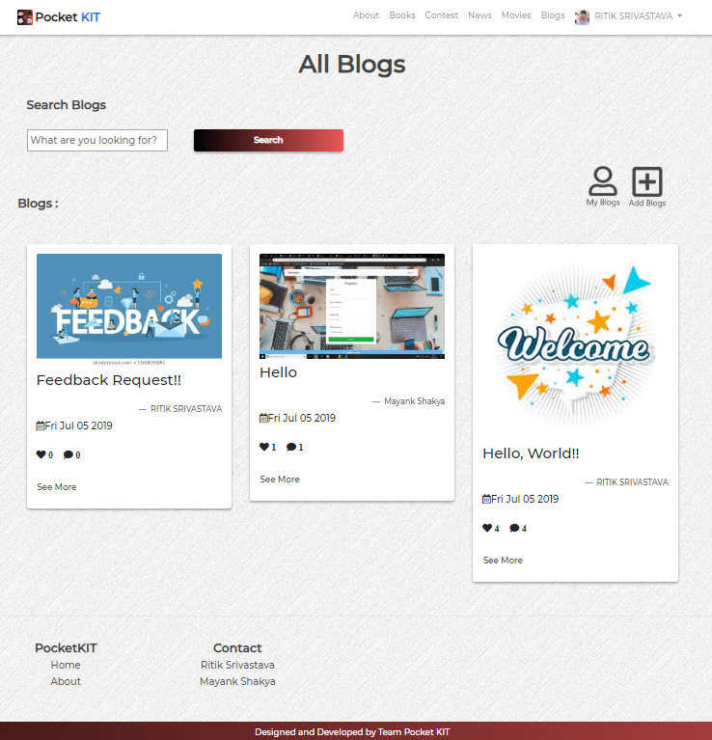
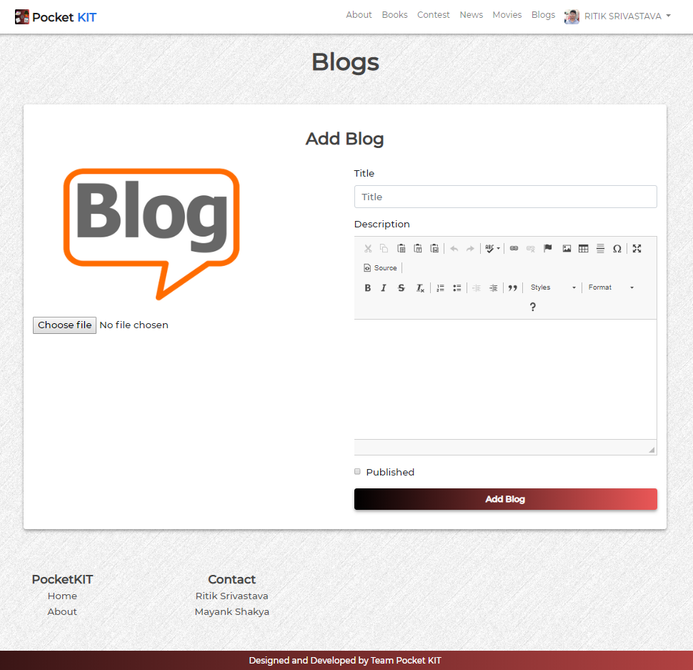
BLOGS MODULE

Slide 16
BLOGS MODULE
The Blogs module is the most practical and feature furnished module of the application.
Features:
View Blogs: The homepage of blogs displays all the blogs posted by users on the platform sorted by the date of creation in descending order. User can also search for blogs by title or category.
View Blogs by User: Each blog has author name displayed on the front, which on clicking will show all the blogs posted by that author/user.
View Personal Blogs: There is a link of My Blogs where user can view blogs posted by him.
Create a Blog: A logged in user can add his blog by going to add a blog option. There is an option to upload an image if he wants otherwise a default image will be displayed with his blog.
Update/Delete Blog: A logged in user can update or delete his blog by going to blog details and then update/delete options.
Like and Comment: Users can leave a like or comment on the blogs posted by the users on the platform. Like is limited to one like per person per blog while comments can be any in number.

Slide 17
SOURCE CODE:
https://github.com/ritiksr25/pocketkit
LIVE APPLICATION:
https://pocketkit.herokuapp.com

Slide 18
DESIGNED AND DEVELOPED WITH ❤️ BY
RITIK SRIVASTAVA (@ritiksr25)
1802913135
MAYANK SHAKYA (@mayanksh99)
1802913092

Slide 19
Thanks!!

